Slide 1
Lecture 3
CS404: Software Engineering
Software & Software Engineering
Software Engineering: A Practitioner’s Approach, 7/e
by Roger S. Pressman
Slides copyright © 1996, 2001, 2005, 2009 by Roger S. Pressman
Software Engineering 9/e
By Ian Sommerville

Slide 2
Software Myths
Erroneous beliefs about software and the process that is used to build it.
Affect managers, customers (and other non-technical stakeholders) and practitioners
Are believable because they often have elements of truth,
but …
Invariably lead to bad decisions,
therefore …
Insist on reality as you navigate your way through software engineering

Slide 3
Software Myths Examples
Myth 1: Once we write the program and get it to work, our job is done.
Reality: the sooner you begin writing code, the longer it will take you to get done. 60% to 80% of all efforts are spent after software is delivered to the customer for the first time.
Myth 2: Until I get the program running, I have no way of assessing its quality.
Reality: technical review are a quality filter that can be used to find certain classes of software defects from the inception of a project.
Myth 3: software engineering will make us create voluminous and unnecessary documentation and will invariably slow us down.
Reality: it is not about creating documents. It is about creating a quality product. Better quality leads to a reduced rework. Reduced work results in faster delivery times.
Many people recognize the fallacy of the myths. Regrettably, habitual attitudes and methods foster poor management and technical practices, even when reality dictates a better approach.

Slide 4
How It all Starts
SafeHome:
Every software project is precipitated by some business need—
the need to correct a defect in an existing application;
the need to the need to adapt a ‘legacy system’ to a changing business environment;
the need to extend the functions and features of an existing application, or
the need to create a new product, service, or system.

Slide 5
Case studies
A personal insulin pump
An embedded system in an insulin pump used by diabetics to maintain blood glucose control.
A mental health case patient management system
A system used to maintain records of people receiving care for mental health problems.
A wilderness weather station
A data collection system that collects data about weather conditions in remote areas.

Slide 6
Insulin pump control system
Collects data from a blood sugar sensor and calculates the amount of insulin required to be injected.
Calculation based on the rate of change of blood sugar levels.
Sends signals to a micro-pump to deliver the correct dose of insulin.
Safety-critical system as low blood sugars can lead to brain malfunctioning, coma and death; high-blood sugar levels have long-term consequences such as eye and kidney damage.

Slide 7
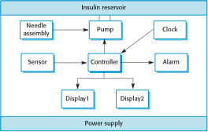
Insulin pump hardware architecture

Slide 8
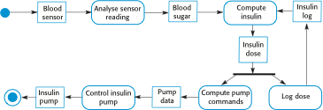
Activity model of the insulin pump

Slide 9
Essential high-level requirements
The system shall be available to deliver insulin when required.
The system shall perform reliably and deliver the correct amount of insulin to counteract the current level of blood sugar.
The system must therefore be designed and implemented to ensure that the system always meets these requirements.

Slide 10
End of lecture 3

